Slide 1
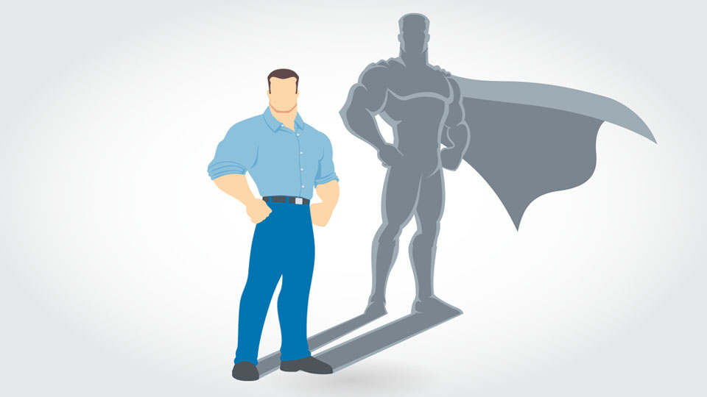
Who is your Role Model ?

Slide 2
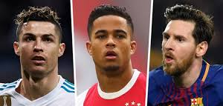

Slide 3
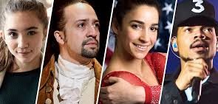

Slide 4
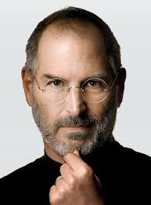
Businessmen as a Role model

Slide 5
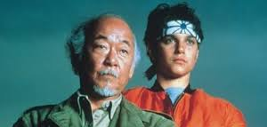

Slide 6
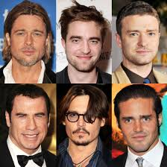
Actors as Role Model

Slide 7
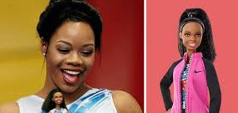

Slide 8
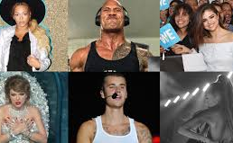
Instagram role model

Slide 9
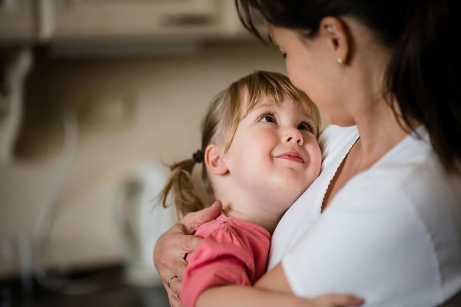
Parents’ Role Model

Slide 10
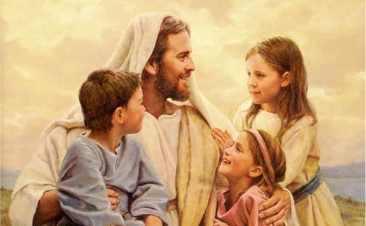
Jesus - my Role Model

Slide 11
“Jesus replied, "Let it be this way for now. It is right for us to do this. It carries out God's holy plan." Then John agreed.”
Matthew 3:15 NIRV

Slide 12
“As soon as Jesus was baptized, he came up out of the water. At that moment heaven was opened. Jesus saw the Spirit of God coming down on him like a dove. A voice from heaven said, "This is my Son, and I love him. I am very pleased with him."”
Matthew 3:16-17 NIRV

Slide 13
“Jesus answered by quoting Deuteronomy: “It takes more than bread to stay alive. It takes a steady stream of words from God’s mouth.”
Matthew 4:4 MSG

Slide 14
“When he saw the crowds, he had compassion on them because they were harried and helpless, like sheep without a shepherd.”
Mattityahu (Mat) 9:36 CJB

Slide 15
How can I account for this generation? The people have been like spoiled children whining to their parents, ‘We wanted to skip rope, and you were always too tired; we wanted to talk, but you were always too busy.’

Slide 16
John came fasting and they called him crazy. I came feasting and they called me a lush, a friend of the riffraff. Opinion polls don’t count for much, do they? The proof of the pudding is in the eating.”
Matthew 11:16-19 MSG

Slide 17
“Jesus resumed talking to the people, but now tenderly. “The Father has given me all these things to do and say. This is a unique Father-Son operation, coming out of Father and Son intimacies and knowledge.

Slide 18
No one knows the Son the way the Father does, nor the Father the way the Son does. But I’m not keeping it to myself; I’m ready to go over it line by line with anyone willing to listen.”
Matthew 11:25-27 MSG

Slide 19
“Are you tired? Worn out? Burned out on religion? Come to me. Get away with me and you’ll recover your life. I’ll show you how to take a real rest. Walk with me and work with me—watch how I do it

Slide 20
Learn the unforced rhythms of grace. I won’t lay anything heavy or ill-fitting on you. Keep company with me and you’ll learn to live freely and lightly.”
Matthew 11:28-30 MSG

